Slide 1
Java Package

Slide 2
A java package is a group of similar types of classes, interfaces and sub-packages.
Package in java can be categorized in two form, built-in package and user-defined package.
There are many built-in packages such as java, lang, awt, javax, swing, net, io, util, sql etc.

Slide 3
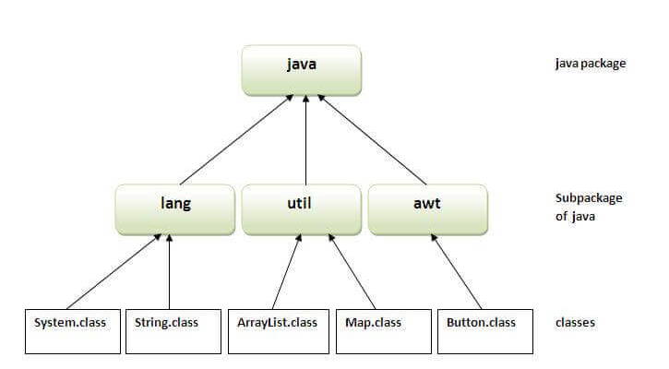
Advantage of Java Package
1)Java package is used to categorize the classes and interfaces so that they can be easily maintained.
2) Java package provides access protection.
3) Java package removes naming collision.

Slide 4
Simple example of java package
The package keyword is used to create a package in java.
//save as Simple.java
package mypack;
public class Simple{
public static void main(String args[]){
System.out.println("Welcome to package");
}
}

Slide 5
How to compile java package
javac -d directory javafilename
For example
javac -d . Simple.java
The -d switch specifies the destination where to put the generated class file. You can use any directory name like /home (in case of Linux), d:/abc (in case of windows) etc. If you want to keep the package within the same directory, you can use . (dot).

Slide 6
How to run java package program
You need to use fully qualified name e.g. mypack.Simple etc to run the class.
To Compile: javac -d . Simple.java
To Run: java mypack.Simple
Output:Welcome to package
The -d is a switch that tells the compiler where to put the class file i.e. it represents destination. The . represents the current folder.

Slide 7
How to access package from another package?
There are three ways to access the package from outside the package.
import package.*;
import package.classname;
fully qualified name.

Slide 8
1) Using packagename.*
If you use package.* then all the classes and interfaces of this package will be accessible but not subpackages.
The import keyword is used to make the classes and interface of another package accessible to the current package.
Example of package that import the packagename.*

Slide 9
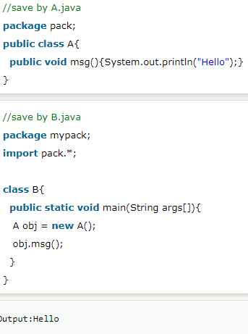
Example

Slide 10
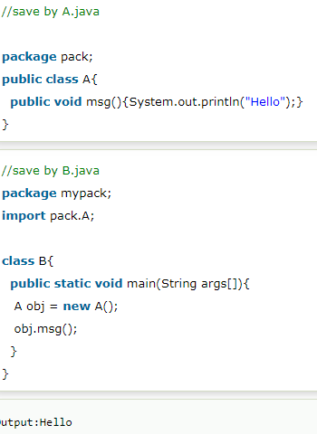
2) Using packagename.classname
If you import package.classname then only declared class of this package will be accessible.
Example of package by import package.classname

Slide 11
3) Using fully qualified name
If you use fully qualified name then only declared class of this package will be accessible. Now there is no need to import. But you need to use fully qualified name every time when you are accessing the class or interface.
It is generally used when two packages have same class name e.g. java.util and java.sql packages contain Date class.

Slide 12
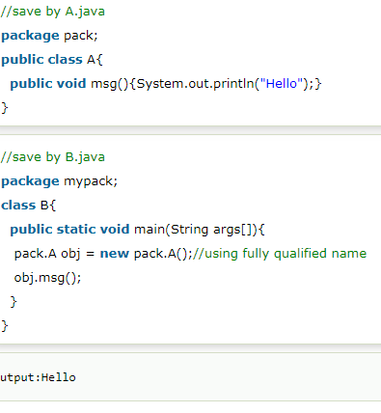
Example

Slide 13
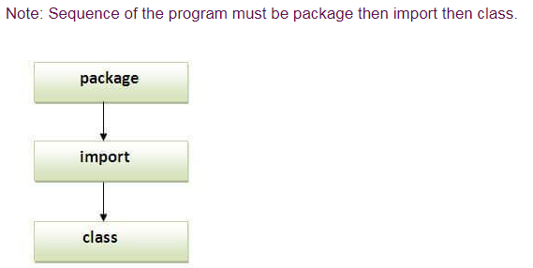
Note
If you import a package, all the classes and interface of that package will be imported excluding the classes and interfaces of the subpackages. Hence, you need to import the subpackage as well.

Slide 14
Subpackage in java
Package inside the package is called the subpackage. It should be created to categorize the package further.
Let's take an example, Sun Microsystem has definded a package named java that contains many classes like System, String, Reader, Writer, Socket etc. These classes represent a particular group e.g. Reader and Writer classes are for Input/Output operation, Socket and ServerSocket classes are for networking etc and so on. So, Sun has subcategorized the java package into subpackages such as lang, net, io etc. and put the Input/Output related classes in io package, Server and ServerSocket classes in net packages and so on.

Slide 15
Example of Subpackage
package com.javat.core;
class Simple{
public static void main(String args[]){
System.out.println("Hello subpackage");
}
}
To Compile: javac -d . Simple.java
To Run: java com.javat.core.Simple
Output:Hello subpackage

Slide 16
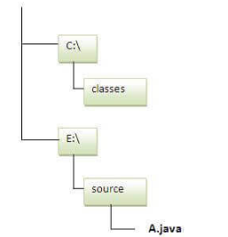
How to send the class file to another directory or drive?

Slide 17
package mypack;
public class Simple{
public static void main(String args[]){
System.out.println("Welcome to package");
}
}
Compile: e:\sources> javac -d c:\classes Simple.java
Run:
To run this program from e:\source directory, you need to set classpath of the directory where the class file resides.
e:\sources> set classpath=c:\classes;.;
e:\sources> java mypack.Simple

Slide 18
Another way to run this program by -classpath switch of java:
The -classpath switch can be used with javac and java tool.
To run this program from e:\source directory, you can use -classpath switch of java that tells where to look for class file. For example:
e:\sources> java -classpath c:\classes mypack.Simple

